Slide 1
The Energy Change of Reactions & bonds Tuesday 21st April 2026
Unscramble the keywords
mitexcehro
emnihrcdote
vtacnatiio rgenye
threalm egyenr
rfdantrrese
rgssinnodruu
kanet ni
mreupetetar
ereicnas
eaecsdre
Exothermic
Endothermic
Activation energy
Thermal energy
Transferred
Surroundings
Taken in
Temperature
Increase
Decrease

Slide 2
Energy changes of reactions
Learning objectives:
Describe the energy changes in bond breaking and bond making.
Explain how a reaction is endothermic or exothermic overall.
Calculate the energy transferred in chemical reactions using bond energies.

Slide 3

The Energy Change of Reactions
Think about WHY:
+ BOND BREAKING
Why do exothermic reactions release heat energy into the surroundings?
Why do endothermic reactions take in heat energy from the surroundings?
- BOND MAKING

Slide 4
+ BOND BREAKING
It takes energy to break bonds, so bond breaking is an endothermic + process:
H
Endothermic processes use the + sign
as energy has to be put into the system!
H
C
H
H

Slide 5
- BOND MAKING
Energy is released when new bonds are made, so bond making is an exothermic - process:
Exothermic processes use the - sign
as energy is released from the system and transferred to the surroundings.
O
C
O

Slide 6

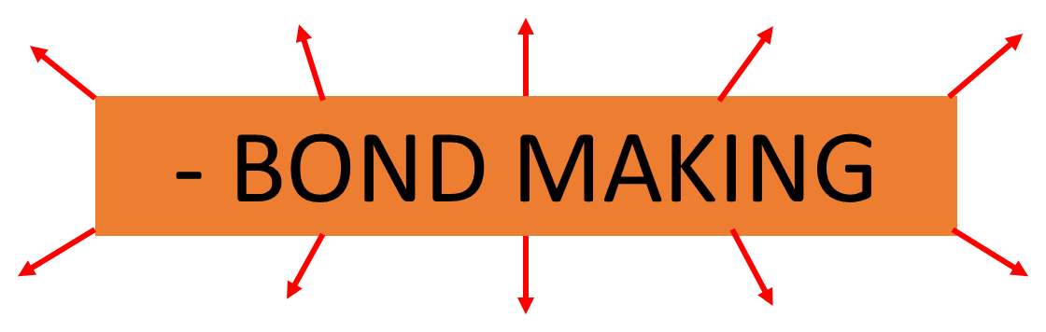
We can use the difference between:
Energy put in during
Energy released during
VS
To calculate the overall energy change and see if it is exothermic or endothermic.

Slide 7
Bond Energy
Bond energy is measured in kJ/mol.
We can use bond energy to calculate energy change (ΔH) for many reactions
The energy released when a bond is formed or absorbed when it is broken is called the bond energy.
e.g. the C-H bond in methane has a bond energy of 413 KJ/mol
You will get a table of the most common bond energies in the exam

Slide 8
Task - Word Problems: Endothermic or Exothermic?
Exothermic:
the energy released from forming new bonds is greater than the energy needed to break existing bonds.
Endothermic:
the energy needed to break existing bonds is greater than the energy released from forming new bonds

Slide 9
Example Calculating Energy Change Calculation – Combustion of Methane
1. You may be given a balanced reaction equation:
3. You will be given displayed formulae for the reactants and products.
CH₄ + 2 O₂ CO₂ + 2 H₂O
H
H
C
H
O
O
2. You will be given a table of bond energies:
H
Bond | Bond energy in kJ
C-H | 413
O=O | 498
C=O | 799
O-H | 463
H
H
O
C
O
O

Slide 10
4. Draw a reaction scheme and consider all bonds broken and all bonds formed.
Bond | Bond energy in kJ
C-H | 413
O=O | 498
C=O | 799
O-H | 463
CH₄+ 2 O₂ CO₂ + 2 H₂O
H
O
O
H
C
H
O
C
O
H
H
O
O
O
H
H
H
O
Bonds broken
Bonds made
4 x C-H
2 x O=O
4 x 413 kJ/Mol
= 1652 kJ
2 x C=O
2 x 799 kJ
= 1598 kJ
+
+
2 x 498 kJ/Mol
= 996 kJ
4 x O-H
4 x 463 kJ
= 1852 kJ
Total energy in = 2648 kJ/Mol
Total energy released = 3450 kJ/Mol
5. Reactants minus products: 2648kJ - 3450kJ = - 802 kJ
The energy change is negative so the reaction is exothermic overall. This is how much energy is released.

Slide 11
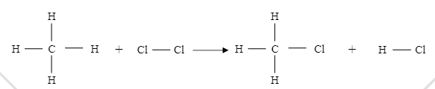
Calculate the energy change in the reaction
Bond | Bond energy (KJ)
C----- H | 412
Cl-----Cl | 242
C-----Cl | 338
H-----Cl | 431
Bonds broken
Bonds made
4 x C-H
1 x Cl -Cl
4 x 412 kJ/Mol
= 1648 kJ
3 x C-H
3 x 412 kJ
= 1236 kJ
+
+
1 x 242 kJ/Mol
= 242 kJ
1 x C- Cl
1 x 338 kJ
= 338 kJ
1 x H- Cl
1 x 431 kJ
= 431 kJ
Total energy in = 1890 kJ/Mol
Total energy released = 2005 kJ/Mol
5. Reactants minus products: 1890kJ - 2005kJ = - 115 kJ
The energy change is negative so the reaction is exothermic overall. This is how much energy is released.

Slide 12
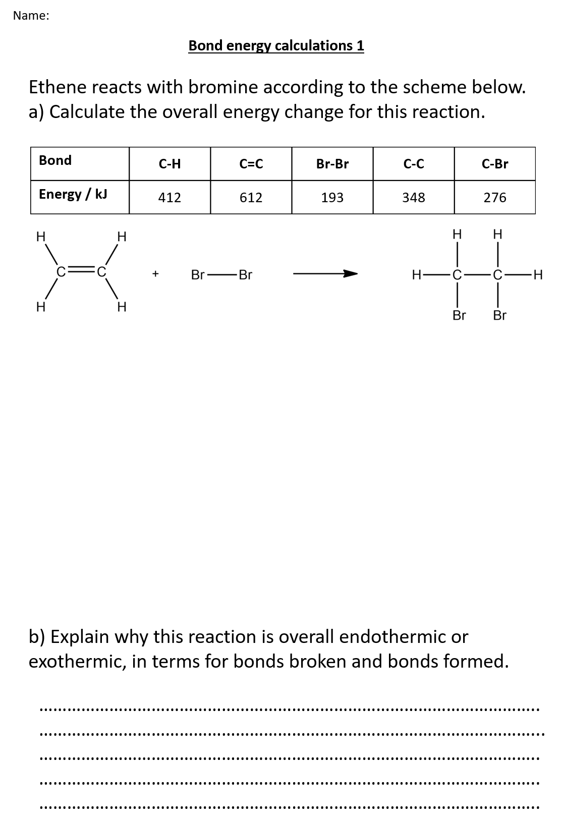
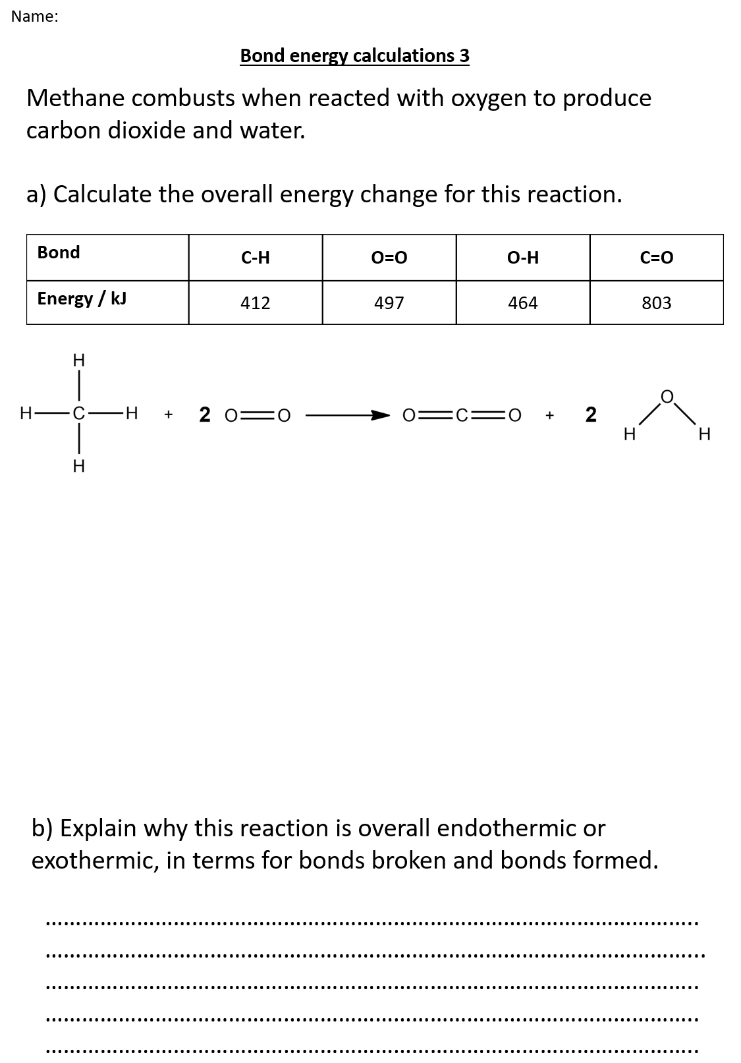
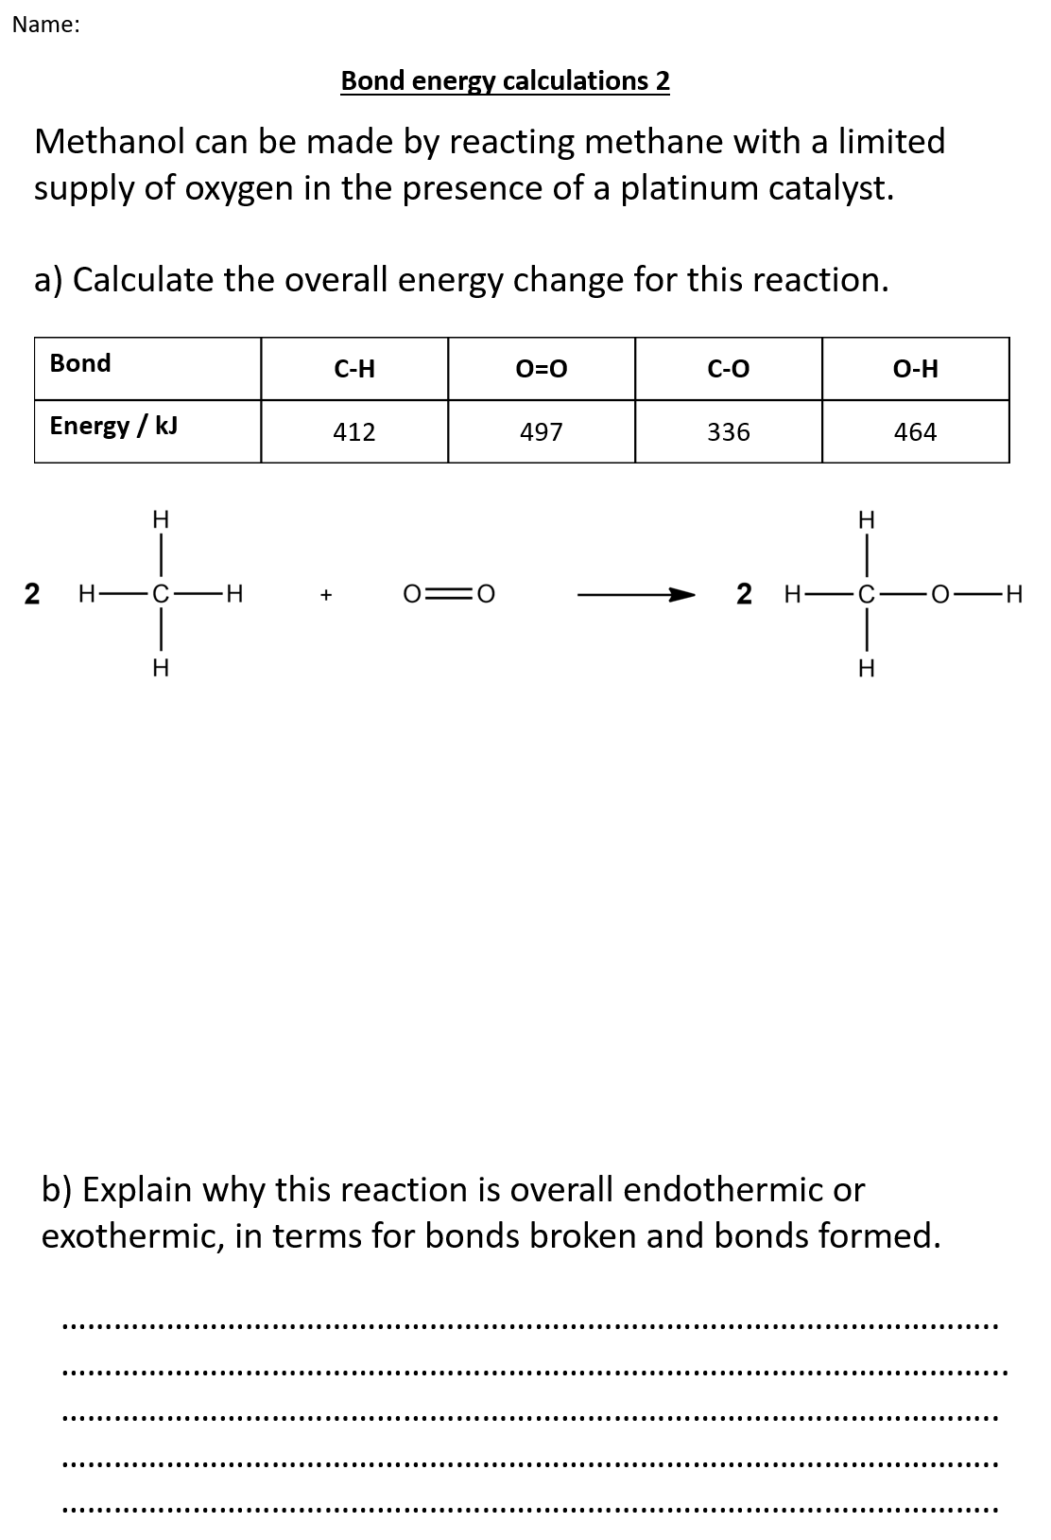
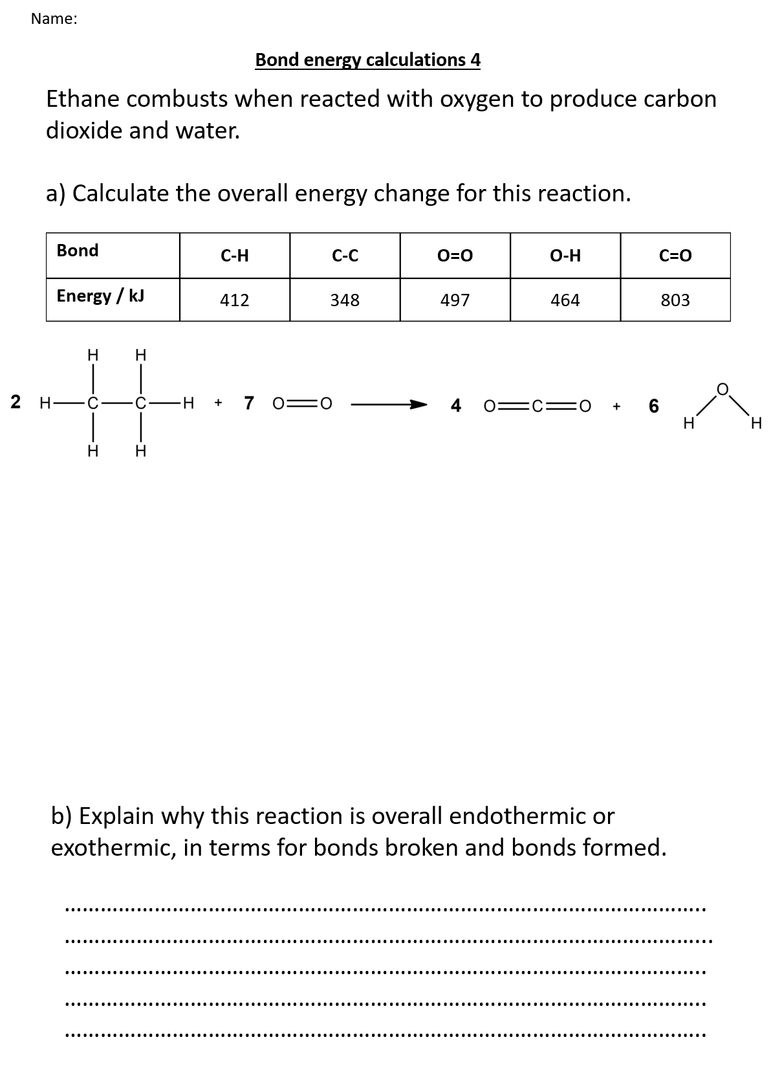
Complete Bond Energy Calculations

Slide 13
Task: Complete Bond Energy Calculations
C/W

Slide 14
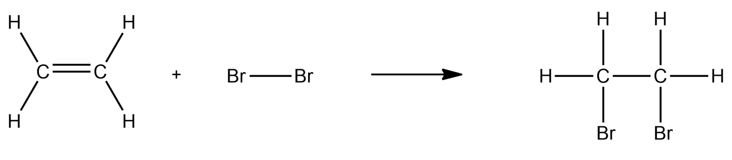
Self Assess – Bond energy calculations 1
Ethene reacts with bromine according to the scheme below.
a) Calculate the overall energy change for this reaction.
Bond | C-H | C=C | Br-Br | C-C | C-Br
Energy / kJ | 412 | 612 | 193 | 348 | 276
Bonds broken
Bonds made
4 x C-H = 4 x 412 = 1648
4 x C-H = 4 x 412 = 1648
+
+
1 x C=C = 1 x 612 = 612
1 x C-C = 1 x 348 = 348
+
+
1 x Br-Br = 1 x 193 = 193
2 x C-Br = 2 x 276 = 552
2453 kJ
2548 kJ
Reactants minus products = 2453 – 2548 = - 95 kJ

Slide 15
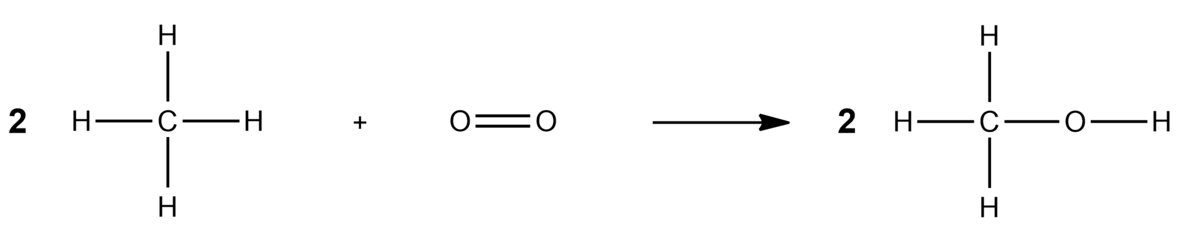
Self Assess – Bond energy calculations 2
C/W
Methanol can be made by reacting methane with a limited supply of oxygen in the presence of a platinum catalyst.
a) Calculate the overall energy change for this reaction.
Bond | C-H | O=O | C-O | O-H
Energy / kJ | 412 | 497 | 336 | 464
Bonds broken
Bonds made
8 x C-H = 8 x 412 = 3296
6 x C-H = 6 x 412 = 2472
+
+
1 x O=O = 1 x 497 = 497
2 x C-O = 2 x 336 = 672
+
2 x O-H = 2 x 464 = 928
3793 kJ
4072 kJ
Reactants minus products = 3793 – 4072 = - 279 kJ

Slide 16
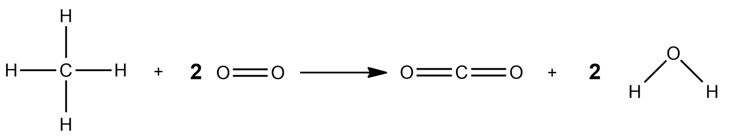
Self Assess – Bond energy calculations 3
C/W
Methane combusts when reacted with oxygen to produce carbon dioxide and water – Values changed from original example so can be used as further practice!
a) Calculate the overall energy change for this reaction.
Bond | C-H | O=O | O-H | C=O
Energy / kJ | 412 | 497 | 464 | 803
Bonds broken
Bonds made
4 x C-H = 4 x 412 = 1648
2 x C=O = 2 x 803 = 1606
+
+
2 x O=O = 2 x 497 = 994
4 x O-H = 4 x 464 = 1856
2642 kJ
3462 kJ
Reactants minus products = 2642 – 3462 = - 820 kJ

Slide 17
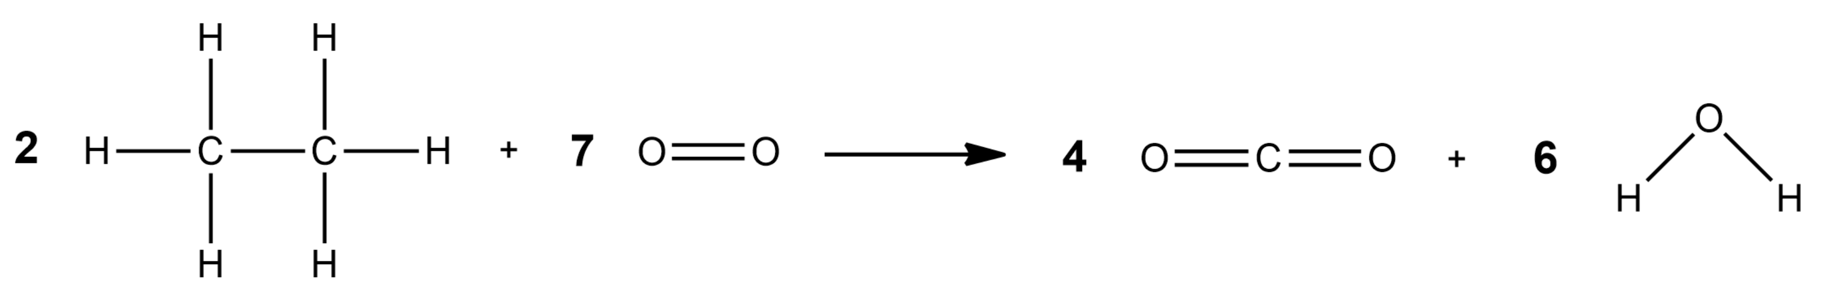
Self Assess – Bond energy calculations 4
C/W
Ethane combusts when reacted with oxygen to produce carbon dioxide and water.
a) Calculate the overall energy change for this reaction.
Bond | C-H | C-C | O=O | O-H | C=O
Energy / kJ | 412 | 348 | 497 | 464 | 803
Bonds broken
Bonds made
12 x C-H = 12 x 412 = 4944
8 x C=O = 8 x 803 = 6424
+
+
2 x C-C = 2 x 348 = 696
12 x O-H = 12 x 464 = 5568
+
7 x O=O = 7 x 497 = 3479
11992 kJ
9119 kJ
Reactants minus products = 9119 – 11992 = - 2873 kJ

Slide 18
Self Assess – Follow up Q
b) Explain why this reaction is overall endothermic or exothermic, in terms for bonds broken and bonds formed.
All reactions were exothermic because:
Overall, more energy is released during bond making.
Than was taken in during bond breaking.

